Slide 1
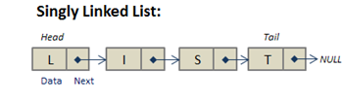
M03 L18 Singly Linked Lists

Slide 2
Today
Check In
Quiz
Project
GE03 Tech Doc - should include code from all lecture labs you are supposed to complete
Goals
Understand Different Data Structures
Understand why linked lists are used instead of arrays.
Implement a sorted Singly Linked List with insertion and deletion

Slide 3
Core CS Courses and Registration

Slide 4
Small Group Presentations

Slide 5
Memory Allocation
Library app used 2d array
Static Data Structures
When the size does not change during program execution
int[] numberList = new int [50]; //Container for 50 integer values
Dynamic Data Structures
When the size changes during program execution
Requires dynamic memory allocation
Obtaining and releasing memory during program execution
Dynamic Memory Allocation
In Java, all objects are allocated on the heap
A reference to the object is stored in stack memory
Programmer is NOT responsible for freeing the heap memory
Garbage collector takes care of memory deallocation on the heap (JVM controls)

Slide 6
Arrays
With an array, once the size is set it is fixed
When don’t know how big the array needs to be, we waste memory and make it extra big
Memory is consecutive
Accessing elements is easy through index notation
Inserting new elements at the front of the array can be expensive
Deleting elements also causes problems
Array could become full

Slide 7
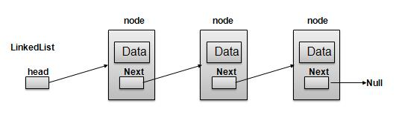
Linked Lists
A linked list is a sequence of data structures that are connected together, called nodes.
A linked list is accessed via a pointer to the first node of the list. Subsequent nodes are accessed via the link pointer member stored in each node.
The link pointer in the last node of a list is set to NULL to mark the end of the list. Data is stored in a linked list dynamically—each node is created as necessary. A node can contain data of any type including other structs.
Each node contains two parts:
Data – The actual value stored in the node.
Pointer (Reference) – A reference to the next node in the sequence.

Slide 8
ArrayList vs Linked List
LinkedList
Stores elements in a linked list data structure
Dynamic data structure
No need to know the size for entire list before execution time
No need to waste memory
Grows and shrinks dynamically during program execution
Memory is generally not contiguous
Blocks (i.e., nodes) are allocated and linked together with references (pointers)
Not as easy to access as an array
Can insert values anywhere into the linked list
Easier to keep list in sorted order
Can delete items from anywhere in the linked list
Number of nodes only limited by amount of memory on system
Efficient: inserting/deleting at beginning of the list
Inefficient: retrieving element from given index
ArrayList
Stores elements in a resizable-array data structure
If the capacity of the array is exceeded
A larger new array is created, and
All elements from current array are copied to the new array
Memory is contiguous
Accessing elements is easy through get method (uses index notation under the covers)
Efficient: random access through an index
Inefficient: inserting or deleting at beginning of list

Slide 9
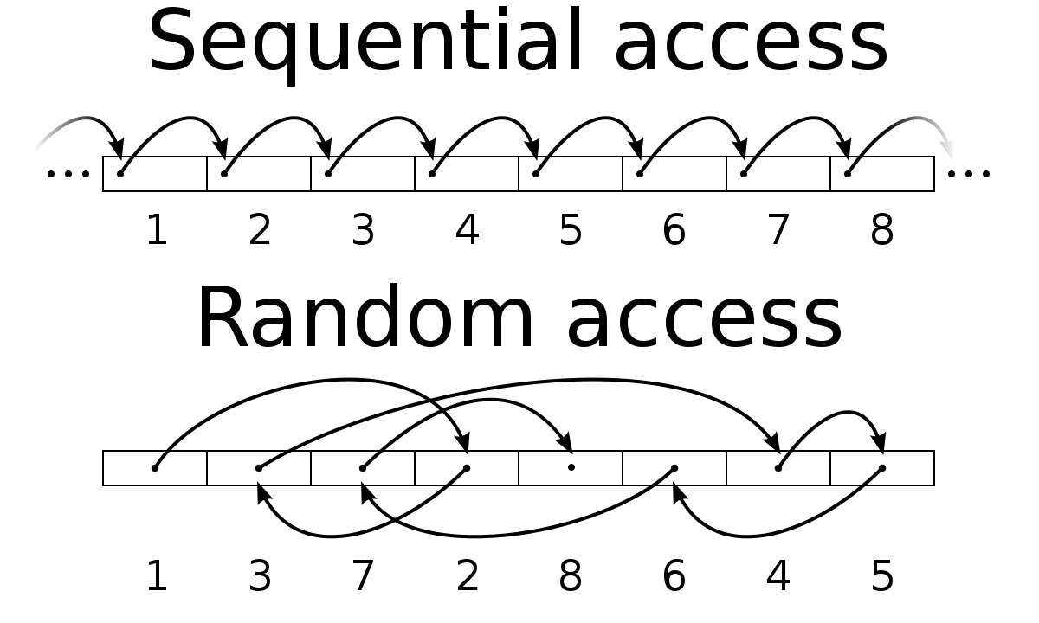
Accessing Elements in a List
Random Access: The ability to access any element instantly using an index, without having to traverse other elements. This is due to being stored in contiguous memory.
Example: array[3] or arrayList.get(3) retrieves the 4th element directly.
Used in: Arrays, ArrayLists (indexed structures)
Sequential Access: Requires traversing elements one by one to reach the desired element.
Example: To get the 4th element in a Linked List, we must start at the head and follow the links.
Used in: Linked Lists, Stacks, Queues

Slide 10
Singly Linked List Example (Using Java Collections Framework)
Java provides a linked list (queue and stack) class
Used in most cases when implementing a linked list in industry.
Remember, reusing stable code is always better to use than creating your own.
Why don’t we just implement the Collections Framework and be done with it? It is important to learn the details of the data structures to become a skilled developer, it is important to know:
The underlying details.
How these data structures are implemented.
How to design, implement, and manipulate complex data structures.
Future Benefits
When the structures in the Collections framework don’t cover your case, you’ll need to create your own.
To develop the skill in dealing with complex problems which is what you will be doing on a daily basis as a software engineer.
To gain experience in writing a known solution.
Interviewers love to ask questions about data structures!

Slide 11

Self-Referential Class
When a class member is a reference (pointer) to its same class type
Visually
Self-referential classes are drawn differently than regular classes.
The above student object should be viewed as a box with two sections:
The 1st for the data (instance variables)
The 2nd for the reference (pointer) to another student (this is the link!)
class Student {
private String name;
private double[] grades;
private Student next;
public Student (String name, Student next){
this.name = name;
this.next = next;
}
} // Student

Slide 12
Singly Linked List
Create nodes using self-referential structures
Each node represents one element in the linked list
Each node contains two parts:
Data field
The information the node holds
Next field
stores the memory address (reference) of the next Node object in the list.
Nodes are allocated when needed on the heap
Nodes are objects that you link together to form linked data structures
Class defining a node:
class Node{
int data;
Node next; //Self-referential
public Node(int data) // Constructor {
this.data = data;
this.next = null;
}
}

Slide 13
Operations on a Linked List
Insertion
Insert at the beginning Insert at the end
Insert at a specific position
Example: Adding a new student record without shifting elements like in an array.
Deletion
Delete the first node
Delete the last node
Delete a node by value
Traversing a linked list
Similar to iterating a 1D array, but we follow next pointers.

Slide 14
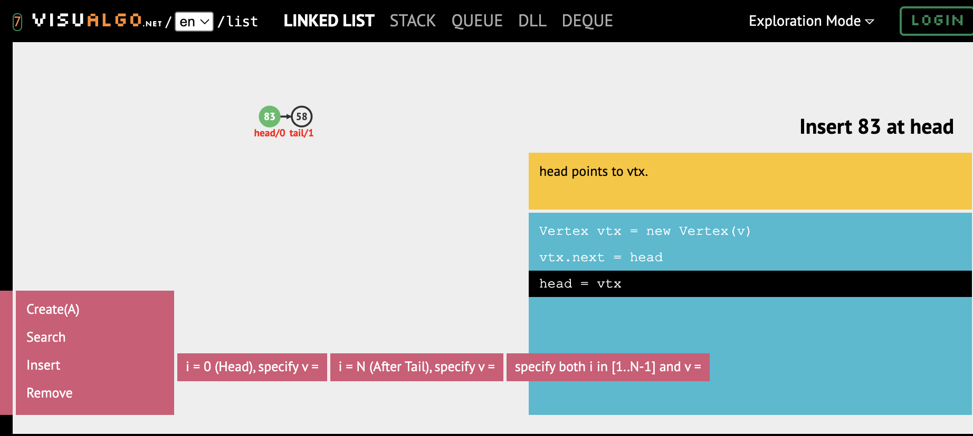
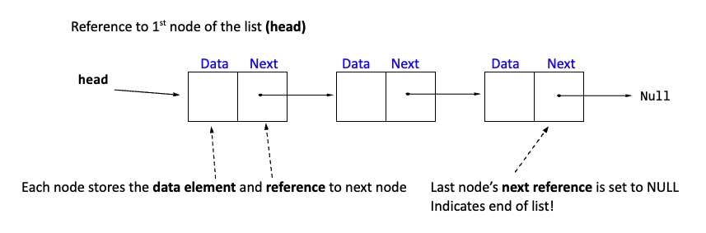
Linking Nodes
Explore Linked List (Single) VisuAlgo focusing on insert and remove.
Do not worry about the tail.

Slide 15
Head
Must keep track of the first node to know the start of the linked list
Create a simple linked list with numbers => {2, 4, 6}
First create the first node and assign it to the head.
Just like an array holds the address to where the array starts in memory the head holds the address to the first node in the linked list
class Node{
int data;
Node next; /
public Node(int data) {
this.data = data;
this.next = null;
}
}
// Initialize head node
Node head = null;
//create new node
Node node = new Node(2);
// Set the head to new node
head = node;
Write on paper How could you add the next node 4 to the linked list?

Slide 16
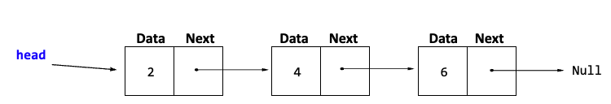
Simple Linked List – Define structure
Link the next node in code.
class Node{
int data;
Node next; /
public Node(int data) {
this.data = data;
this.next = null;
}
}
// Initialize head node
Node head = null;
//create new node
Node node = new Node(2);
// Set the head to new node
head = node;
// Create a node for the 2nd element
node = new Node(4);
head.next = node;
How could you add the next node 6?

Slide 17


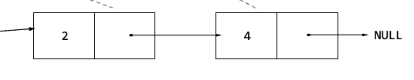


Link Nodes
Each node is created as needed that contains the data integer and the pointer to next node
Need a reference to first node called the head and a reference to point to next node
head
What would a better way to add nodes to a linked list?
Node head = null;
Node node = new Node(2);
head = node;
node = new Node(4);
head.next = node;
node = new Node(6)
head.next.next = node
head
How would you iterate to print all the data in a linked list? Write ideas on paper then discuss.
head

Slide 18
Mystery Function
2 Explain what the mystery functions is doing if the head of the linked list that was just created is passed.
public void mystery(Node head)
{
Node current = head;
while (current != null)
{
System.out.print(current.data + " -> ");
current = current.next;
}
System.out.println("null");
}

Slide 19

Lab: Insert and Delete Nodes in Ordered Singly Linked List
Use test driven development to create unit tests for an Ordered Singly Linked List to
Insert nodes to create an ordered singly linked list
Deleting nodes from singly linked list
• Predict what insertNode() should do for a middle insertion
• Predict what deleteNode() should do for first/last node
• Sketch expected before/after diagrams
What are various cases for adding or deleting? Draw pictures to to come up with different pre and post conditions.
For example, insert 5 (or delete 2) with this list as a precondition. What are other types of scenarios?
Split up so one pair does insert and one pair does delete
Note that not all linked lists need to be ordered but we will explore ordered in this lab.

Slide 20
Discuss test cases with another group.
Jigsaw grouping to discuss test cases and then work on algorithm
Insert Case | Precondition (list state) | Postcondition (list state)
Insert at head | head: 3 → 4 → 6 → null, insert 2 | head: 2 → 3 → 4 → 6 → null
Insert in middle | head: 2 → 4 → 6 → null, insert 5 | head: 2 → 4 → 5 → 6 → null
Insert at end | head: 2 → 4 → 6 → null, insert 9 | head: 2 → 4 → 6 → 9 → null
Insert into empty list | head: null, insert 7 | head: 7 → null
Insert duplicate (allowed) | head: 2 → 4 → 5 → null, insert 5 | head: 2 → 4 → 5 → 5 → null
Delete Case | Precondition (list state) | Postcondition (list state)
Delete head | head: 2 → 4 → 6 → null, delete 2 | head: 4 → 6 → null
Delete in middle | head: 2 → 4 → 6 → 9 → null, delete 6 | head: 2 → 4 → 9 → null
Delete at end | head: 2 → 4 → 6 → 9 → null, delete 9 | head: 2 → 4 → 6 → null
Delete only node (single-node list) | head: 5 → null, delete 5 | head: null
Value not found | head: 2 → 4 → 6 → null, delete 7 | head: 2 → 4 → 6 → null

Slide 21
Algorithm For Deleting Node in Ordered Singly Linked List
2 Use test driven development to design algorithm, implement part of the algorithm and test.
When working with insertion in linked lists, we must keep track of:
current: The node we are currently examining.
previous: The node before current, which helps adjust pointers.
Tracking Pointer
previous starts as null and follows current as we traverse.
current moves forward to find the correct position.
Case: Insert between two existing nodes.
For example Insert 5 between 4 and 6
Step | Previous | Current | Action
Start | null | Head (2) | Begin traversal
Move | 2 | 4 | 5 is greater, move forward
Move | 4 | 6 | Stop (5 is smaller than 6)
Insert | 2- 4-5-6 |  | Adjust links
Node newNode = new Node(number);
Node current = head;
Node previous = null;
previous
current

Slide 22
Algorithm For Deleting Node in Ordered Singly Linked List
2 Use test driven development to design algorithm, implement part of the algorithm and test.
When working with insertion in linked lists, we must keep track of:
current: The node we are currently examining.
previous: The node before current, which helps adjust pointers.
Tracking Pointer
previous starts as null and follows current as we traverse.
current moves forward to find the correct position.
Case: Delete between two nodes
For example Delete 4
Step | Previous | Current | Action
Start | null | Head (2) | Begin traversal
Move | 2 | 4 | 4 is greater, move forward
Move | 4 | 6 | Stop (4 is smaller than 6)
Insert | 2-6 |  | Adjust links
previous
current

Slide 23
Hints?
Case | Action | Pointer Updates
Insert at head | New node smaller than current head or empty list | newNode.next = head; head = newNode;
Insert in middle | Between previous and current | newNode.next = current; previous.next = newNode;
Insert at end | After traversal, current == null (last node reached) | newNode.next = null; previous.next = newNode;
Delete at head | Target is first element | head = head.next;
Delete in middle | Found node between two others | previous.next = current.next;
Delete at end | Target node is last (current.next == null) | previous.next = null;

Slide 24
Understanding Linear Data Structures
Data structures that store elements one after another in a linear fashion.
Indexed Structure: Allows direct access to elements using an index (Array, ArrayList).
Ordered Structure: Elements follow a specific sequence (Priority Queue, Sorted List).
Unordered Structure: Elements do not follow a specific order (Linked List, HashSet).
Static vs. Dynamic:
Static Structures: Arrays are the only static data structure, meaning their size is fixed at declaration and cannot change at runtime.
Dynamic Structures: ArrayLists, Linked Lists, Stacks, and Queues can grow or shrink as needed during execution.
Data Structure | Storage Type | Access Type
Array | Static, contiguous memory | Direct (get(i))
ArrayList | Dynamic, contiguous memory | Direct (get(i))
Linked List | Dynamic, noncontiguous memory | Sequential (must traverse)
Stack | Dynamic, noncontiguous memory | Sequential LIFO (Last In, First Out) (top element only)
Queue | Dynamic, noncontiguous memory | Sequential FIFO (First In, First Out)(front/rear operations)

Slide 25
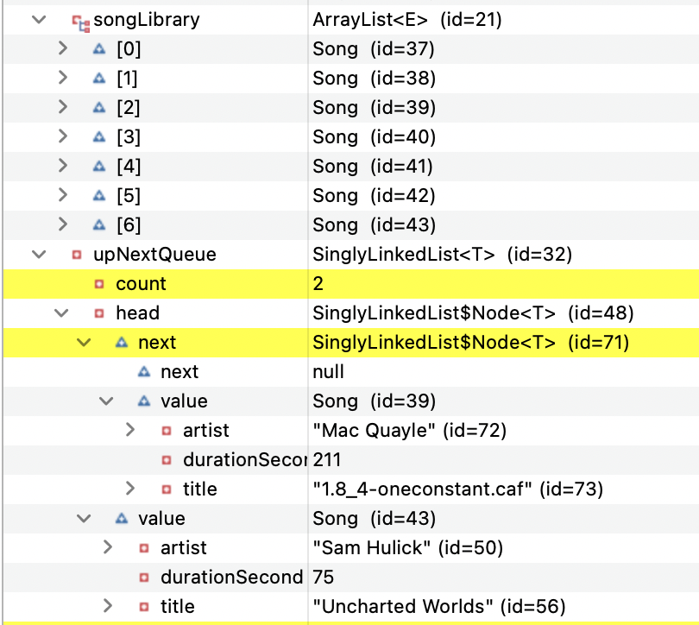
Memory Allocation
ArrayList stored in Consecutive Memory
ArrayList songLibrary variable holds address to start of memory
Can randomly accessing different parts of the array where a calculation of bytes is used to move the correct location
For example 2 means 2 times the number of bytes to find value in correct memory location
SinglyLinkedList memory location
head is a node object in the SinglyLinkedList
next stores memory location of next node object
Contains next node data members
next is null so end of linked list
value stores the song memory location (data)
value for head stores the song memory location (data)
The self-referential structure next is how you get to the next location of information in the linked list

Slide 26
Motivation for Linked Lists
What if we don’t know the number of elements in advance?
What if we want fast insertions and deletions without shifting elements?
Real-world examples:
Train cars (each connected, but not stored in one block of memory)
Playlists, browser history (nodes linked together dynamically)
Now that we can link nodes and maintain order using a head reference, next time we’ll introduce a tail reference for queue operations!

Slide 27
Singly Linked List Applications
Application | How It Uses a Singly Linked List
Memory Allocation (Free Lists) | Tracks free memory blocks for allocation and deallocation.
Symbol Tables in Compilers | Stores symbols in a linked structure for efficient retrieval.
Queue Implementation | Implements FIFO queues efficiently for task scheduling.
File System Directory Structure | Stores hierarchical directories as a singly linked list.
Messaging Systems (Event Queues) | Queues messages or events in messaging platforms.
Network Packet Processing | Processes packets in order, ensuring efficient delivery.
Linked Stack Implementation | Implements stack structures for efficient push/pop operations.
Social Media Feeds | Stores and dynamically loads posts in an efficient manner.

Slide 28
Summary
Sequential storage structures (Lists, Stacks, Queues) organize data differently.
Indexed structures (Arrays, ArrayLists) allow fast random access.
Stacks (LIFO) and Queues (FIFO) process data in order but don’t allow direct access.
Memory efficiency depends on how data is stored—arrays use less memory, linked lists provide flexibility.
Choosing the right structure depends on access speed, insertion/removal needs, and memory constraints.
When to use
Use Arrays/ArrayLists for fast direct access.
Use Linked Lists when frequent insertions/deletions are needed.
Can Apply Stacks and Queues to Arrays, ArrayLists and Linked Lists
Use Stacks when handling Last-In-First-Out (LIFO) operations.
Use Queues when handling First-In-First-Out (FIFO) operations.

Slide 29
Preparation and Lab
The following Java code has errors in the insertNode() and deleteNode() methods FixSinglyLinkedOrderedList.java (Deb can’t write correct code)
Your goal is to find and fix them before running the program.
Debug the code to find issues
Put comments explaining code and what you fixed.
You will upload this for your participation.
Update Technical document to make sure it demonstrates your thorough understanding of the lectures and lab explorations. This is a professional communication containing clear headings, summaries, and examples like visuals, code snippets, and useful links.
Draw your own visuals or use visuals you find but include link to original source
Use the debugger to take screenshots to understand how stored in memory
Summarize concepts and include code examples with comments

